Slide 1
Impact of COVID-19 on Mental Health in United States
Group D1: Jie Feng, Jungkyu Kim, Riley Williamson, Rodney Davemann,Veera Supraja Koppisetty, Felix Ogbodu
Instructor: Thomas Raczkowski
TA: Sumit Malik
Date: 05/01/2021

Slide 2
Introduction
Background:
Covid-19 pandemic
Mental health issue
Questions:
Has COVID_19 affected the mental health of Americans?
Are areas high COVID-19 deaths more impacted by mental health issues?
Do areas with low COVID-19 rates have lower rates of mental health issues?
How has Georgia been impacted?
By Veera Supraja Koppisetty

Slide 3
Data importation and merging
Datasets:
CDC: Indicators_of_Anxiety_or_Depression_Based_on_Reported_Frequency_of_Symptoms_During_Last_7_Days(also called Anxiety_data)
Merging:
Datasets were merged on US states
By Veera Supraja Koppisetty

Slide 4
Data cleaning
By Jungkyu Kim

Slide 5
Data analysis
By Rodney Davemann

Slide 6
Data analysis Question: How has Georgia been impacted?
#get georgia data
georgia_data=merged_data.loc[merged_data["state"]=="Georgia"]
#display georgia data
display(georgia_data)
#group georgia data by date
georgia_data_group_by_date=georgia_data.groupby(["date"],sort=False)
#get the mean
georgia_data_group_by_date_mean=georgia_data_group_by_date.mean()
By Jie Feng

Slide 7
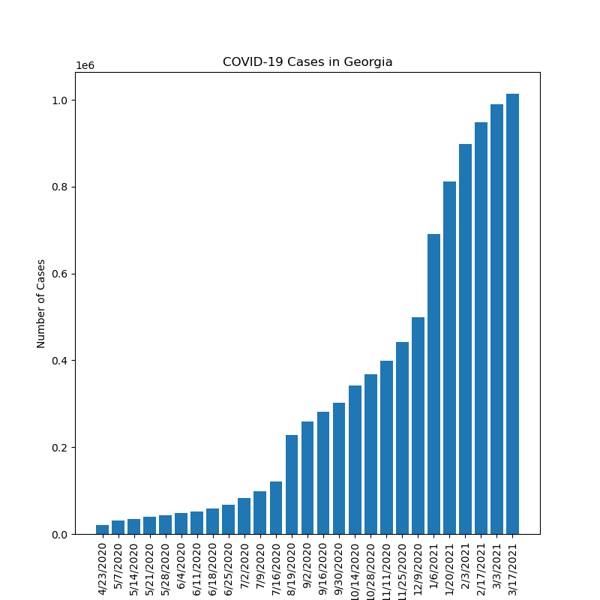
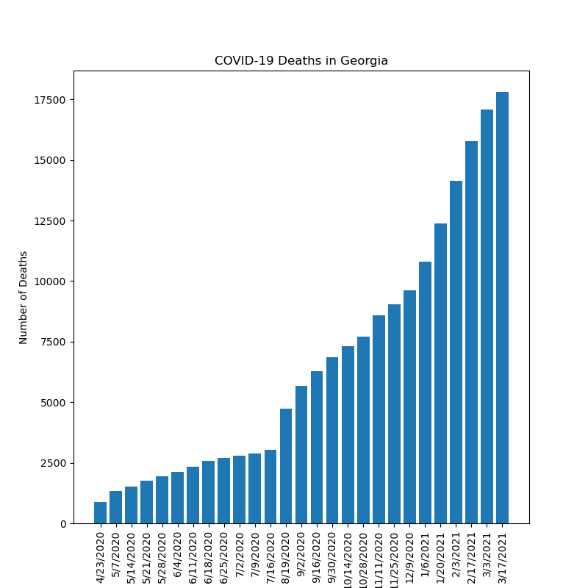
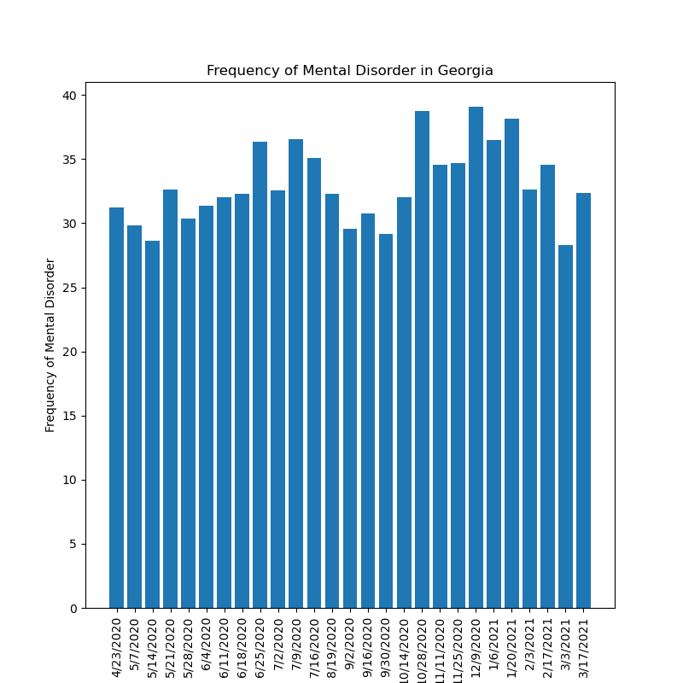
Data analysis Question: How has Georgia been impacted?
By Jie Feng

Slide 8
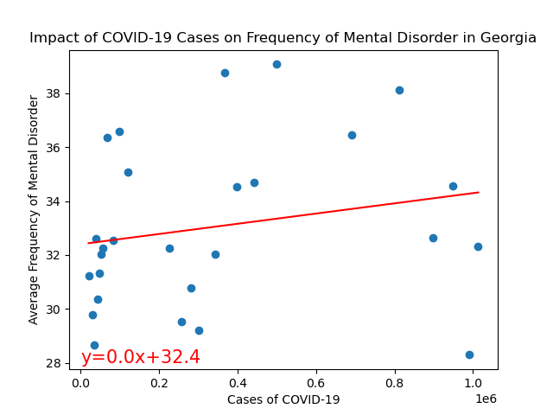
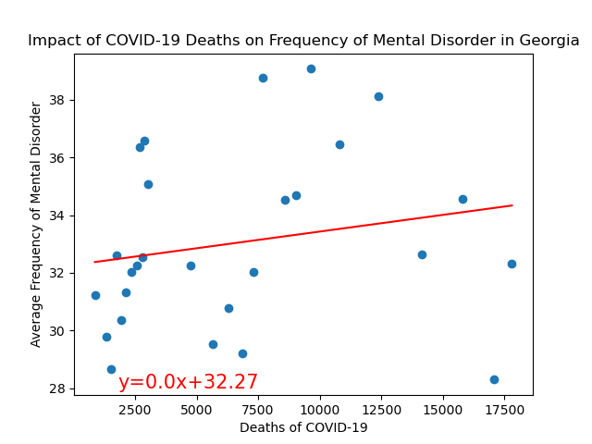
Data analysis Question: How has Georgia been impacted?
The r value is 0.04.
The r value is 0.04.
By Jie Feng

Slide 9
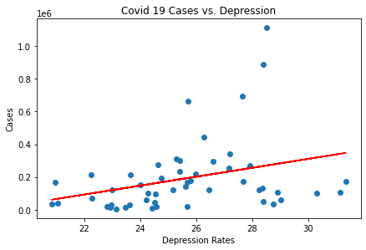
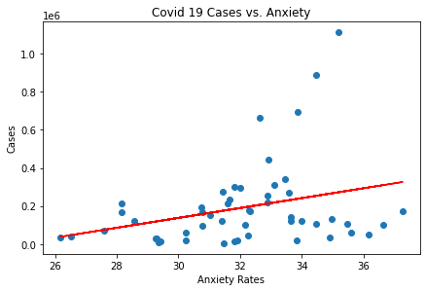
Mental Illness vs COVID-19 Cases
By Felix Ogbodu

Slide 10
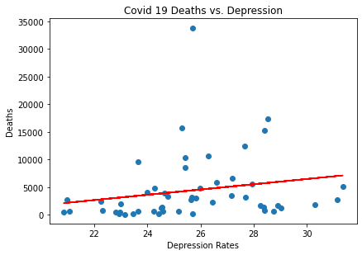
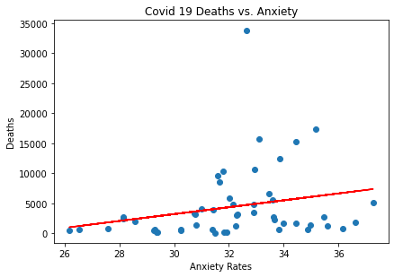
Mental Illness vs COVID-19 Fatality
By Jungkyu Kim

Slide 11
Summary statistics
The total number of cases is 9,762,136.
The total number of deaths is 222,812.
The average rate of anxiety is 32.08%.
The average rate of depression is 25.65%.
The average rate of anxiety or depression symptoms is 36.98%.
The average rate for both anxiety and depression symptoms is 20.72%.
By Riley Williamson

Slide 12
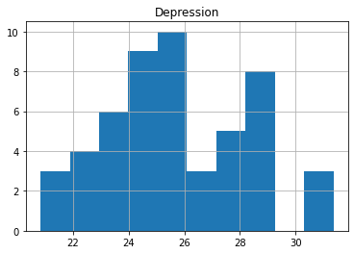
P-test
CDC 2019 Study: 18.5% of Americans have symptoms of depression
H0: 25.63<=18.5 | H1: 25.63>18.5
z-score: 2.795
Confidence level: 95%
p-value: 0.003
Because the p-value is less than the significance level, we have significant evidence to reject the null hypothesis. With this analysis, we can say with 95% confidence that depression rates for Americans have been higher during the pandemic.
By Riley Williamson

Slide 13
Conclusion
By Veera Supraja Koppisetty

